Slide 1
CIRCUIT 7 INTEGRATED PRACTICE TEAM (IPT)
The Integrated Practice Team, is a community-oriented, strength based individualized planning process aimed at helping families meet their needs through informal supports and formal child welfare service systems. The goal of the IPT members is to staff cases as a TEAM and offer knowledge and expertise to develop a comprehensive family service plan WITH the family to ensure the individual needs of the family are strengthened while safely maintaining children in their homes.
The type of cases referred are active investigations or open case management where there is a potential for removal of the children. The process is to identify innovative solutions to safely maintain children in their own home.
BEST PRACTICE POINTS
Co-facilitating by CBCs and DCF-Shared responsibilities between agencies
Travel to service centers to conduct staffing-Easier access for families and staff
Integration with other community stakeholders-minimizing the number of staffings for families and staff

Slide 2
Cumulative Report
May-December 2017

Slide 3
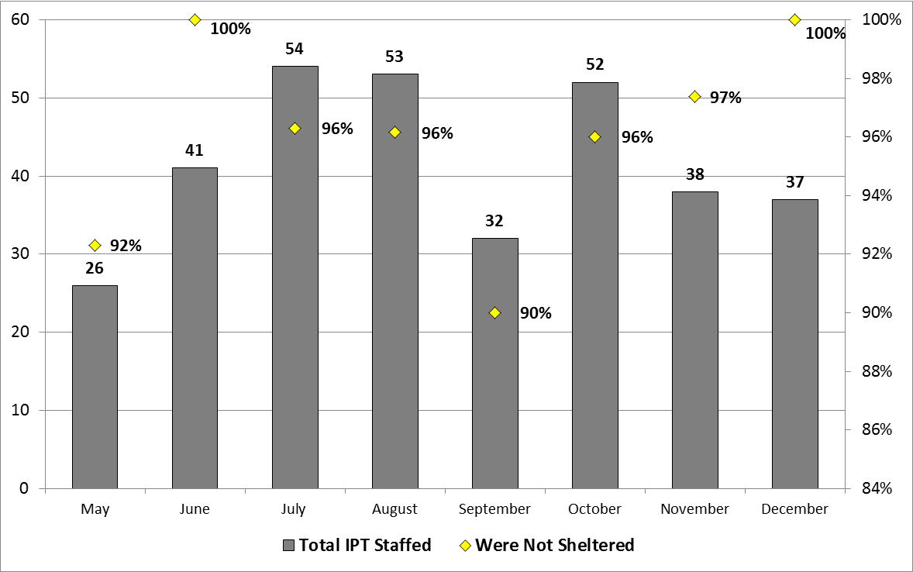
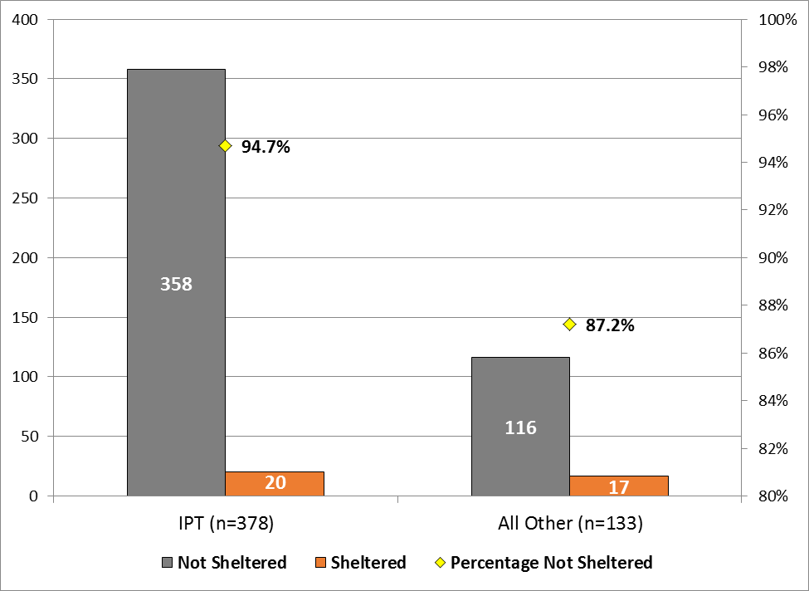
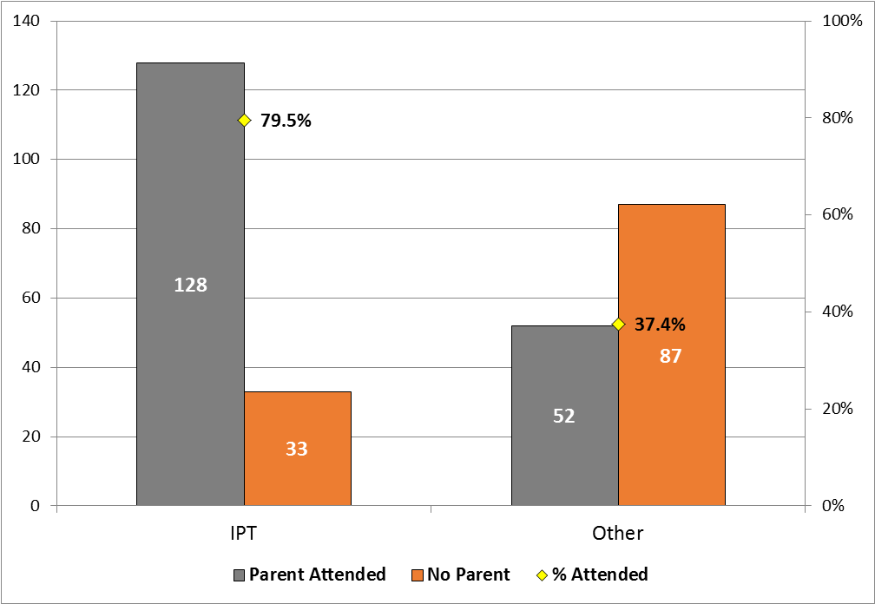
Cumulative Report
May-December 2017
Number of Cases Staffed by IPT and
Percentage Removed by Month
Shelters Resulting from Cases Staffed by IPT versus
All Others with Percentage Removed
Parent Attendance at Initial Cases Staffed by
IPT versus All Others with Percentage in Attendance

